Slide 1
Analysis of Conservation Statuses within National Parks
Laura Hengel​

Slide 2


Agenda
A
Introduction
Data Analysis
Conclusions
Next Steps

Slide 3
Introduction
This project is a result of using the datasets provided by Codecademy for the Biodiversity Portfolio Project.
The data includes information on multiple species regarding their scientific names, common names, conservation statuses, type of species, and the number of observations at each of four national parks.
Analysis was done to determine any trends or patterns among species having a conservation status above Least Concern.

Slide 4
Conservation Statuses in USA
Not Evaluated
Data Deficient
Least Concern
Near Threatened
Species is not published on IUCN Red List
There is not enough data present to make an assessment of the risk of extinction
Species has been evaluated and does not qualify for higher conservation statuses
Species has been evaluated and does not currently qualify, but may in the near future, for higher conservation status
Vulnerable
Endangered
Critically Endangered
Extinct in the Wild
Species is considered to be facing a high risk of extinction in the wild
Species is considered to be facing a very high risk of extinction in the wild
Species is considered to be at an extremely high risk of extinction in the wild
Species has not been successfully recorded in the wild in relation to the species life cycle and life form
Extinct
No reasonable doubt that the last individual has died

Slide 5
Data Tidying and Cleaning
It was found that only 179 species had non-null conservation statuses. These species were the focus of the analysis
There were originally two tables, one containing species information and one containing observation data.
The species table had the scientific name expanded into a genus and a species column
The observation table contained the number of observations of species at one of four national parks. This table was modified to have the following columns: scientific_name, Bryce, Smoky, Yellowstone, Yosemite, and total_observations. The number of observations per park per species were stored under the national park columns.
The two tables were then merged using an inner merge on the scientific name

Slide 6
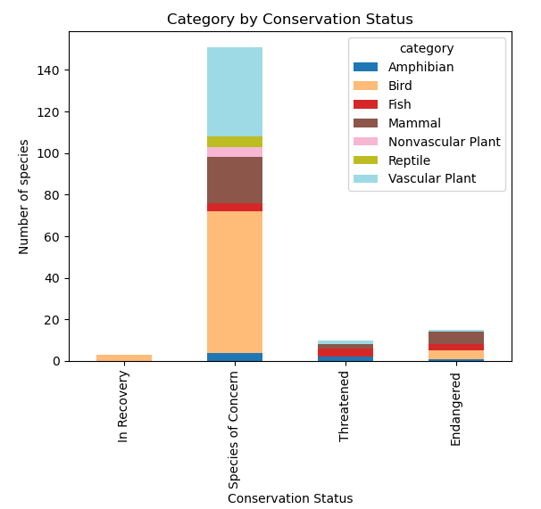
Data Analysis – Category and Conservation Status
The bar graph to the right shows that the majority of species have a status of Species of Concern
Within that status, the three most prevalent categories were Birds, Vascular Plants, and Mammals

Slide 7
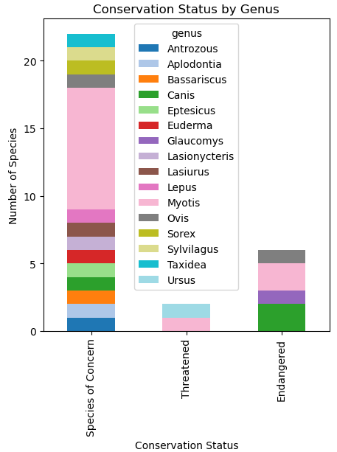
Data Analysis – Conservation Status by Genus
By expanding the scientific name, it was possible to explore the different categories by the genus of the species.
To the right, the graph shows a breakdown of the number of species per genus of the mammals category, grouped by their conservation status
Most genuses have only one species.
The Myotis and Canis genuses each have multiple species that are species to keep an eye on
These correspond to Mouse-eared Bats and Canines, respectively.

Slide 8
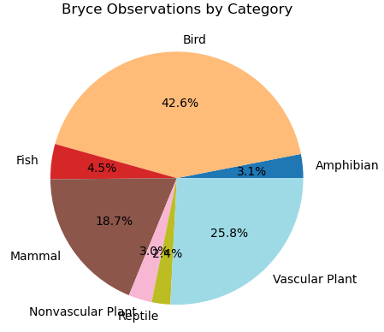
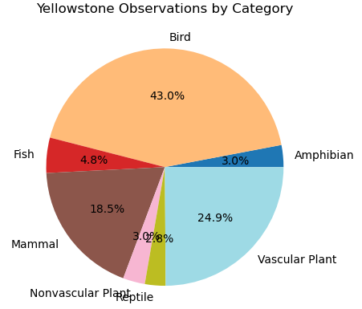
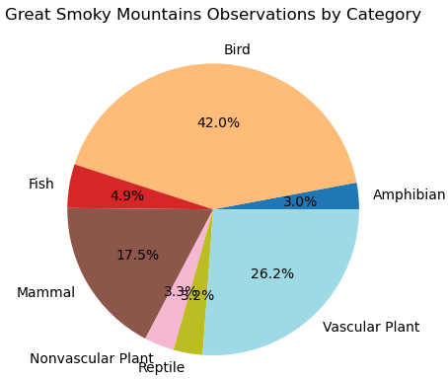

Data Analysis – Observations by Category
The pie charts to the left show the percentage breakdowns of observations by category at each of the four parks in the data.
An interesting insight is that the breakdown of observations is roughly equal between each of the four parks.

Slide 9
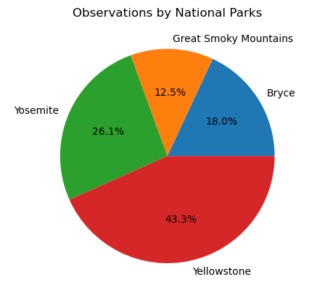
Data Analysis – Percent of Observations by Park
The chart to the right shows the percentage of observations for all species with a conservation status according to the national parks.
Yellowstone National Park accounts for almost half of all the reported observations. Followed in order by Yosemite, Bryce, and Great Smoky Mountains.
Yellowstone is the largest park, followed in order by Yosemite, Great Smoky Mountains, and Bryce.

Slide 10
Conclusions
Although Yellowstone is responsible for almost half of the recorded observations, the breakdown of observations by category per park is almost equal among all four parks. This may speak to the consistency in population between these species categories in parks.
The majority of species with a conservation status are types of birds, followed by vascular plants and mammals.
Another interesting insight is that among mammals, the most affected genus is the Mouse-Eared Bats. Could there be a tighter correlation between birds and mouse-eared bats both being creatures that fly and being prevalent in the Species of Concern?

Slide 11
Next Steps
It would be lovely to have more information related to species that are capable of flight or not as the current data suggests that the most affected species are those that can fly.
The author would also like to expand on the analysis by looking at the data that was not examined (the data that did not have a conservation level defined). Examining this data could give indications on the breakdown of categories. For example, does the breakdown of birds, vascular plants, and mammals continue even in conservation statuses that are not defined?

